Slide 1
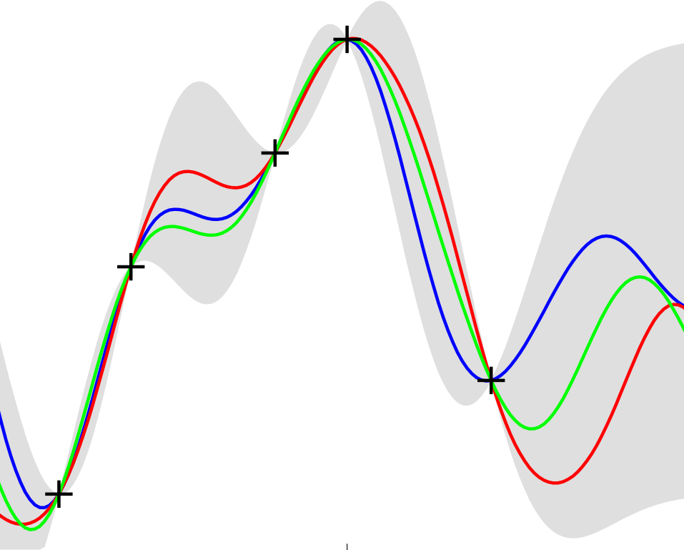
Gaussian Processes for Machine Learning
Chapter 2: Regression
Kirk Swanson
C. E. Rasmussen & C. K. I. Williams, Gaussian Processes for Machine Learning, the MIT Press, 2006, ISBN 026218253X.

Slide 2
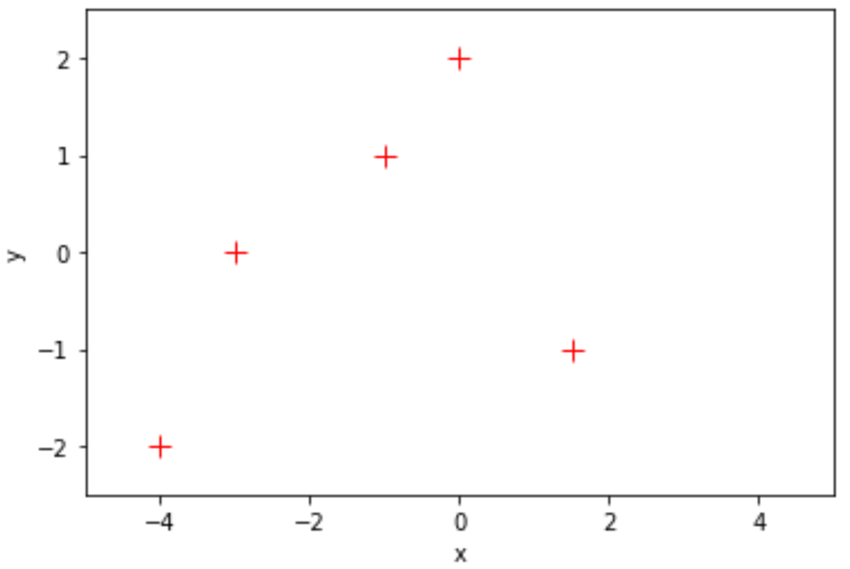
Motivation: non-linear regression
C. E. Rasmussen & C. K. I. Williams, Gaussian Processes for Machine Learning, the MIT Press, 2006, ISBN 026218253X.

Slide 3
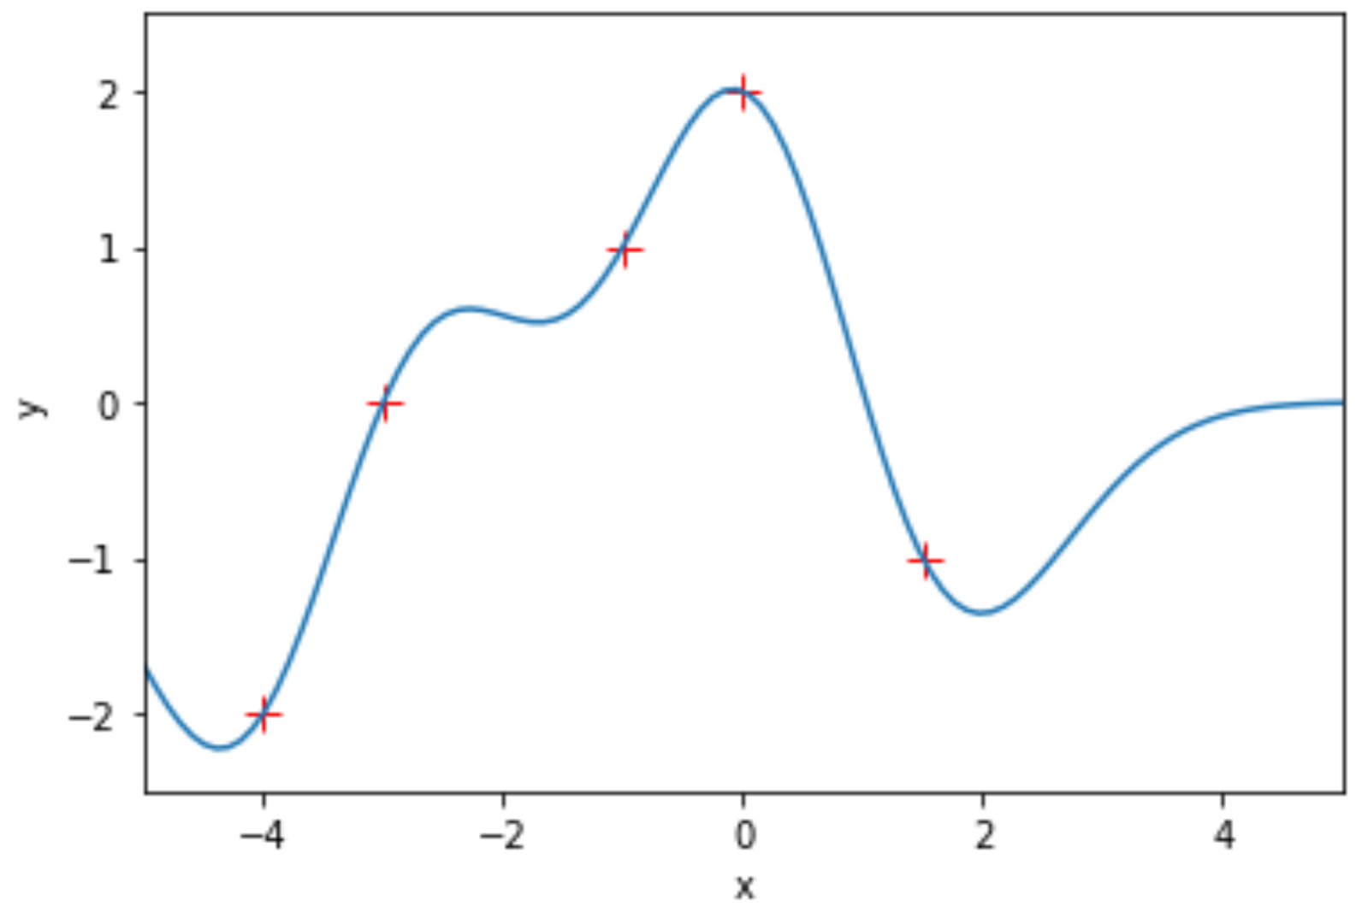
Motivation: non-linear regression
C. E. Rasmussen & C. K. I. Williams, Gaussian Processes for Machine Learning, the MIT Press, 2006, ISBN 026218253X.

Slide 4
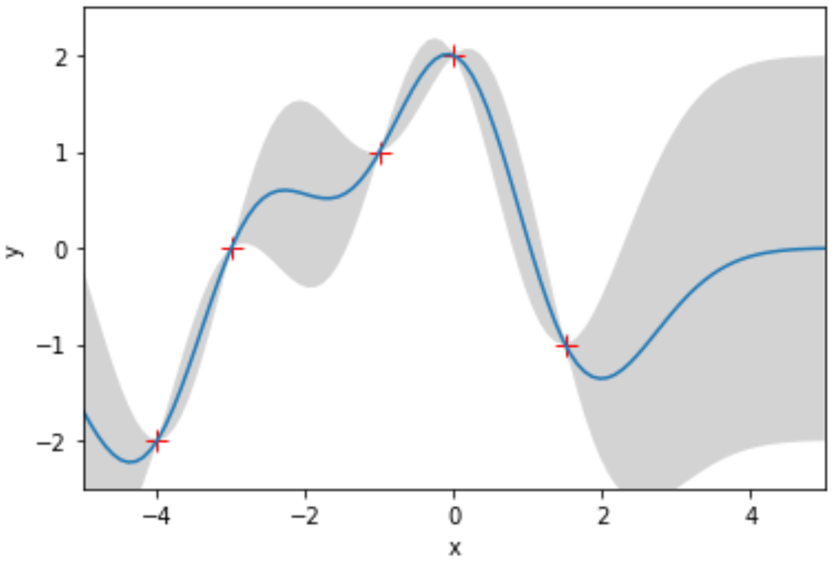
Motivation: non-linear regression
C. E. Rasmussen & C. K. I. Williams, Gaussian Processes for Machine Learning, the MIT Press, 2006, ISBN 026218253X.

Slide 5
Why are Gaussian processes useful and important?
Flexible tool that can be applied to a wide variety of problems, including both regression and classification
Provide well-behaved uncertainty measurements
Other widely-used models are a special case of Gaussian processes
C. E. Rasmussen & C. K. I. Williams, Gaussian Processes for Machine Learning, the MIT Press, 2006, ISBN 026218253X.

Slide 6

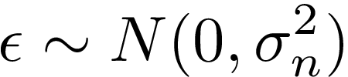
General methods for solving regression problems
Parametric Approach: select a model class
Issues: Underfitting or overfitting
C. E. Rasmussen & C. K. I. Williams, Gaussian Processes for Machine Learning, the MIT Press, 2006, ISBN 026218253X.

Slide 7
General methods for solving regression problems
Parametric Approach: select a model class
Issues: Underfitting or overfitting
Nonparametric Approach: give prior probability to every possible function
C. E. Rasmussen & C. K. I. Williams, Gaussian Processes for Machine Learning, the MIT Press, 2006, ISBN 026218253X.

Slide 8
General methods for solving regression problems
Parametric Approach: select a model class
Issues: Underfitting or overfitting
Nonparametric Approach: give prior probability to every possible function
Problem: how do we compute over this uncountably infinite set?
C. E. Rasmussen & C. K. I. Williams, Gaussian Processes for Machine Learning, the MIT Press, 2006, ISBN 026218253X.

Slide 9
Gaussian process overview
Probability Distribution | Stochastic Process
Governs random variables Applies to scalar or vector values | Governs properties of functions Think (loosely) of function f as infinitely long random vector, where each entry x specifies f(x)
C. E. Rasmussen & C. K. I. Williams, Gaussian Processes for Machine Learning, the MIT Press, 2006, ISBN 026218253X.

Slide 10
Gaussian process overview
Probability Distribution | Stochastic Process
Governs random variables Applies to scalar or vector values | Governs properties of functions Think (loosely) of function f as infinitely long random vector, where each entry x specifies f(x)
Gaussian process is a generalization of the Gaussian probability distribution
C. E. Rasmussen & C. K. I. Williams, Gaussian Processes for Machine Learning, the MIT Press, 2006, ISBN 026218253X.

Slide 11
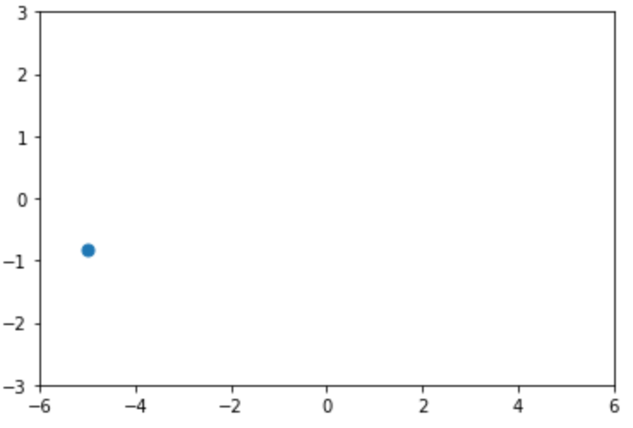


Gaussian process overview
Probability Distribution | Stochastic Process
Governs random variables Applies to scalar or vector values | Governs properties of functions Think (loosely) of function f as infinitely long random vector, where each entry x specifies f(x)
Gaussian process is a generalization of the Gaussian probability distribution
C. E. Rasmussen & C. K. I. Williams, Gaussian Processes for Machine Learning, the MIT Press, 2006, ISBN 026218253X.

Slide 12
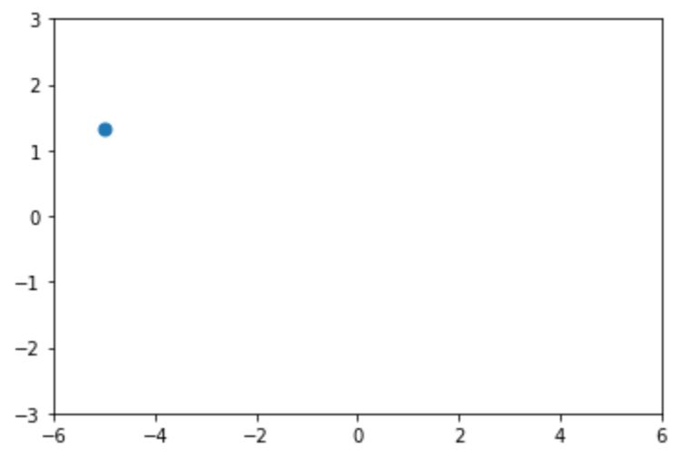
Gaussian process overview
Probability Distribution | Stochastic Process
Governs random variables Applies to scalar or vector values | Governs properties of functions Think (loosely) of function f as infinitely long random vector, where each entry x specifies f(x)
Gaussian process is a generalization of the Gaussian probability distribution
C. E. Rasmussen & C. K. I. Williams, Gaussian Processes for Machine Learning, the MIT Press, 2006, ISBN 026218253X.

Slide 13
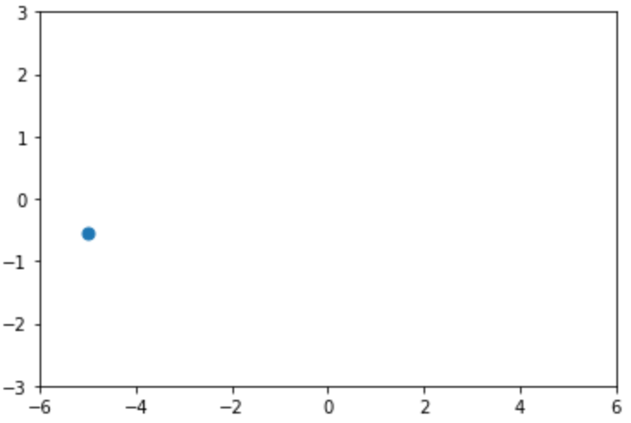
Gaussian process overview
Probability Distribution | Stochastic Process
Governs random variables Applies to scalar or vector values | Governs properties of functions Think (loosely) of function f as infinitely long random vector, where each entry x specifies f(x)
Gaussian process is a generalization of the Gaussian probability distribution
C. E. Rasmussen & C. K. I. Williams, Gaussian Processes for Machine Learning, the MIT Press, 2006, ISBN 026218253X.

Slide 14
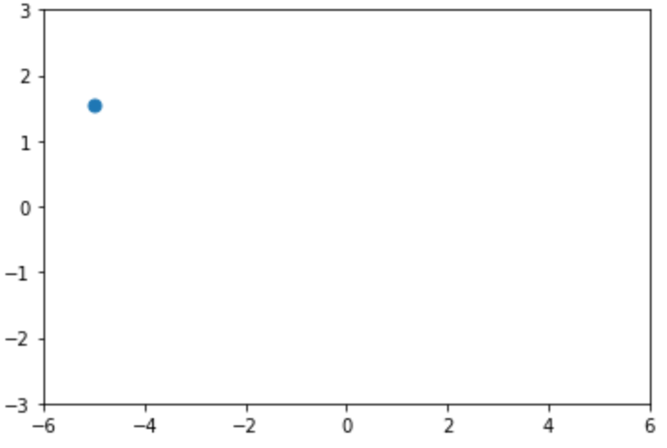
Gaussian process overview
Probability Distribution | Stochastic Process
Governs random variables Applies to scalar or vector values | Governs properties of functions Think (loosely) of function f as infinitely long random vector, where each entry x specifies f(x)
Gaussian process is a generalization of the Gaussian probability distribution
C. E. Rasmussen & C. K. I. Williams, Gaussian Processes for Machine Learning, the MIT Press, 2006, ISBN 026218253X.

Slide 15
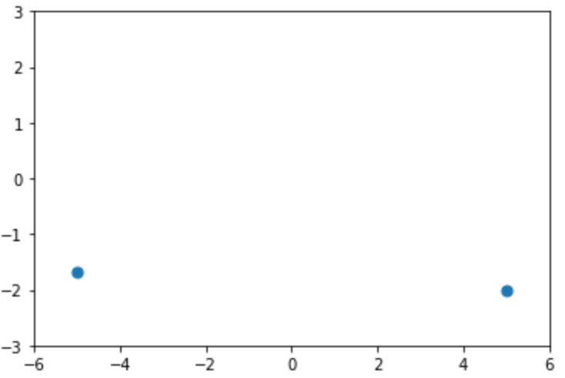
Gaussian process overview
Probability Distribution | Stochastic Process
Governs random variables Applies to scalar or vector values | Governs properties of functions Think (loosely) of function f as infinitely long random vector, where each entry x specifies f(x)
Gaussian process is a generalization of the Gaussian probability distribution
C. E. Rasmussen & C. K. I. Williams, Gaussian Processes for Machine Learning, the MIT Press, 2006, ISBN 026218253X.

Slide 16
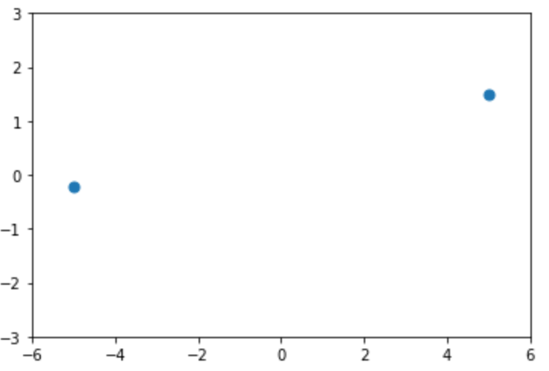
Gaussian process overview
Probability Distribution | Stochastic Process
Governs random variables Applies to scalar or vector values | Governs properties of functions Think (loosely) of function f as infinitely long random vector, where each entry x specifies f(x)
Gaussian process is a generalization of the Gaussian probability distribution
C. E. Rasmussen & C. K. I. Williams, Gaussian Processes for Machine Learning, the MIT Press, 2006, ISBN 026218253X.

Slide 17
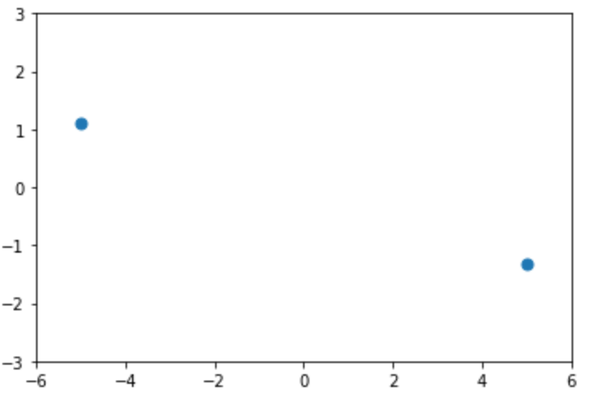
Gaussian process overview
Probability Distribution | Stochastic Process
Governs random variables Applies to scalar or vector values | Governs properties of functions Think (loosely) of function f as infinitely long random vector, where each entry x specifies f(x)
Gaussian process is a generalization of the Gaussian probability distribution
C. E. Rasmussen & C. K. I. Williams, Gaussian Processes for Machine Learning, the MIT Press, 2006, ISBN 026218253X.

Slide 18
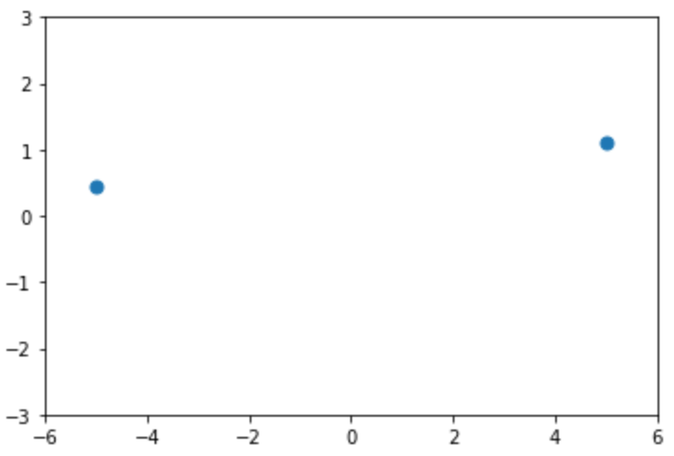
Gaussian process overview
Probability Distribution | Stochastic Process
Governs random variables Applies to scalar or vector values | Governs properties of functions Think (loosely) of function f as infinitely long random vector, where each entry x specifies f(x)
Gaussian process is a generalization of the Gaussian probability distribution
C. E. Rasmussen & C. K. I. Williams, Gaussian Processes for Machine Learning, the MIT Press, 2006, ISBN 026218253X.

Slide 19
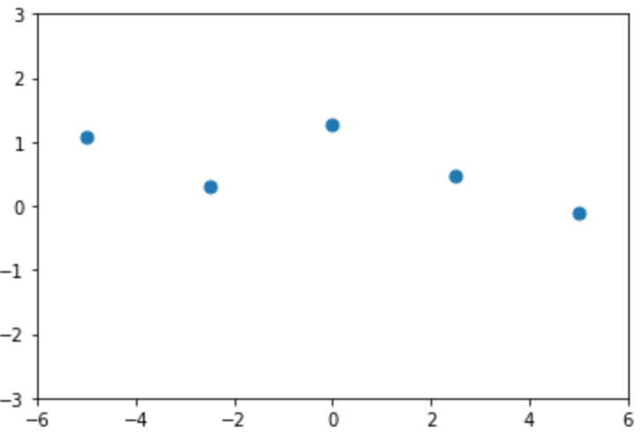
Gaussian process overview
Probability Distribution | Stochastic Process
Governs random variables Applies to scalar or vector values | Governs properties of functions Think (loosely) of function f as infinitely long random vector, where each entry x specifies f(x)
Gaussian process is a generalization of the Gaussian probability distribution
C. E. Rasmussen & C. K. I. Williams, Gaussian Processes for Machine Learning, the MIT Press, 2006, ISBN 026218253X.

Slide 20
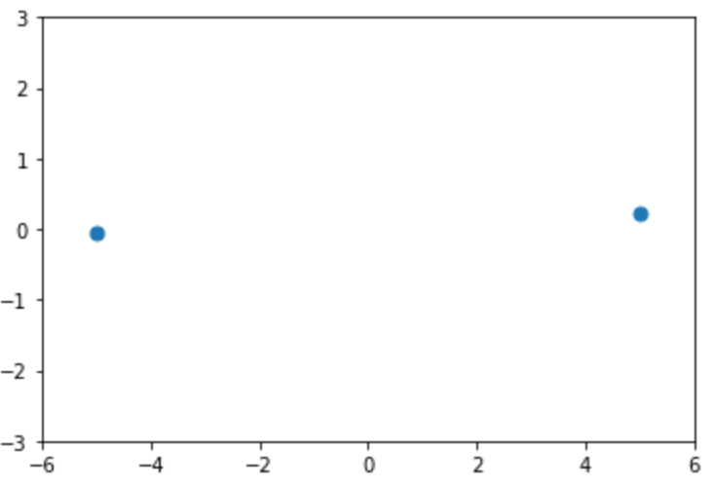
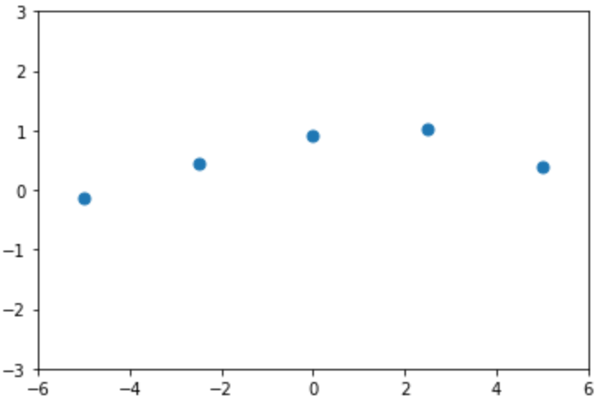
Gaussian process overview
Probability Distribution | Stochastic Process
Governs random variables Applies to scalar or vector values | Governs properties of functions Think (loosely) of function f as infinitely long random vector, where each entry x specifies f(x)
Gaussian process is a generalization of the Gaussian probability distribution
C. E. Rasmussen & C. K. I. Williams, Gaussian Processes for Machine Learning, the MIT Press, 2006, ISBN 026218253X.

Slide 21
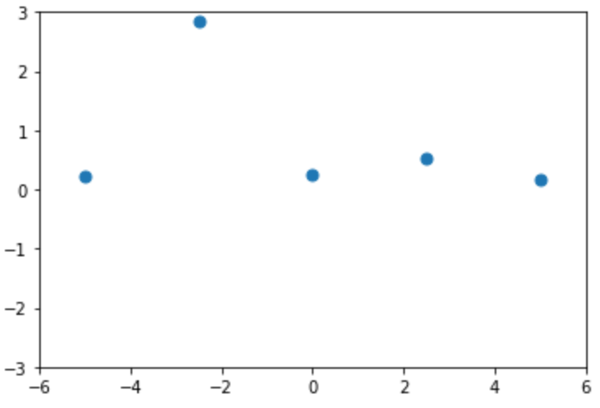
Gaussian process overview
Probability Distribution | Stochastic Process
Governs random variables Applies to scalar or vector values | Governs properties of functions Think (loosely) of function f as infinitely long random vector, where each entry x specifies f(x)
Gaussian process is a generalization of the Gaussian probability distribution
C. E. Rasmussen & C. K. I. Williams, Gaussian Processes for Machine Learning, the MIT Press, 2006, ISBN 026218253X.

Slide 22
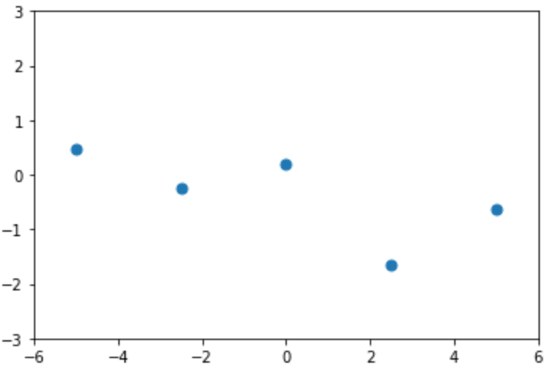
Gaussian process overview
Probability Distribution | Stochastic Process
Governs random variables Applies to scalar or vector values | Governs properties of functions Think (loosely) of function f as infinitely long random vector, where each entry x specifies f(x)
Gaussian process is a generalization of the Gaussian probability distribution
C. E. Rasmussen & C. K. I. Williams, Gaussian Processes for Machine Learning, the MIT Press, 2006, ISBN 026218253X.

Slide 23
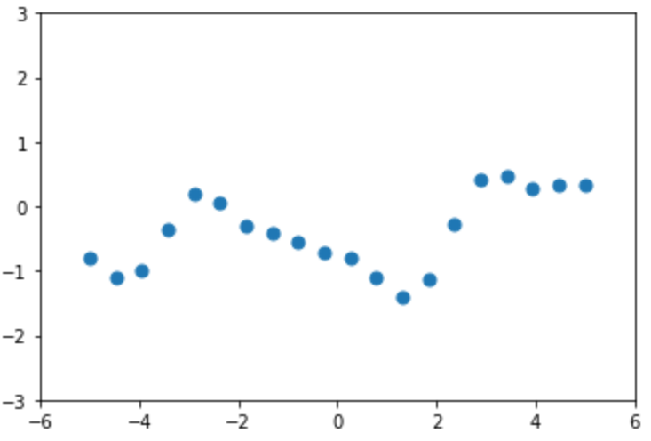
Gaussian process overview
Probability Distribution | Stochastic Process
Governs random variables Applies to scalar or vector values | Governs properties of functions Think (loosely) of function f as infinitely long random vector, where each entry x specifies f(x)
Gaussian process is a generalization of the Gaussian probability distribution
C. E. Rasmussen & C. K. I. Williams, Gaussian Processes for Machine Learning, the MIT Press, 2006, ISBN 026218253X.

Slide 24
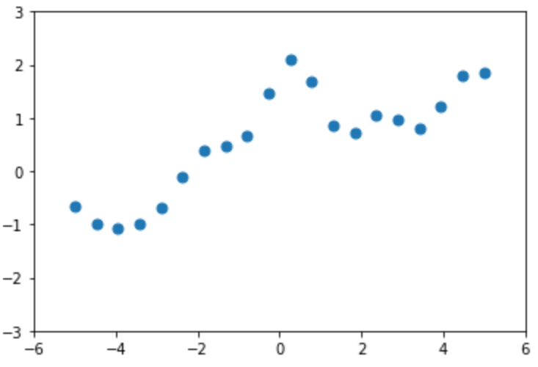
Gaussian process overview
Probability Distribution | Stochastic Process
Governs random variables Applies to scalar or vector values | Governs properties of functions Think (loosely) of function f as infinitely long random vector, where each entry x specifies f(x)
Gaussian process is a generalization of the Gaussian probability distribution
C. E. Rasmussen & C. K. I. Williams, Gaussian Processes for Machine Learning, the MIT Press, 2006, ISBN 026218253X.

Slide 25
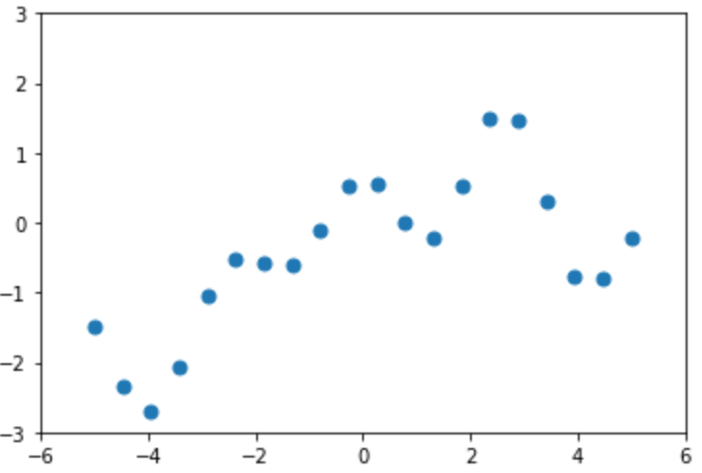
Gaussian process overview
Probability Distribution | Stochastic Process
Governs random variables Applies to scalar or vector values | Governs properties of functions Think (loosely) of function f as infinitely long random vector, where each entry x specifies f(x)
Gaussian process is a generalization of the Gaussian probability distribution
C. E. Rasmussen & C. K. I. Williams, Gaussian Processes for Machine Learning, the MIT Press, 2006, ISBN 026218253X.

Slide 26
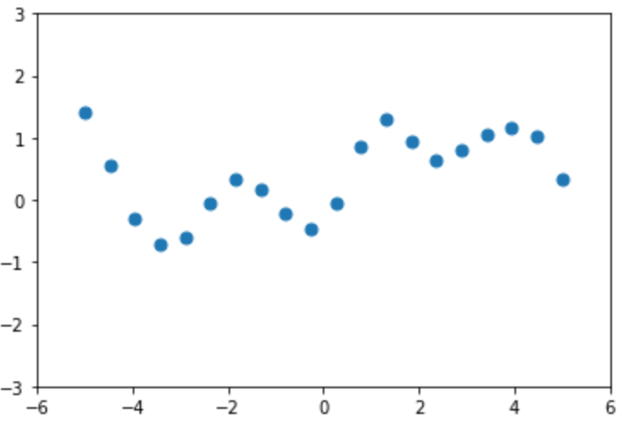
Gaussian process overview
Probability Distribution | Stochastic Process
Governs random variables Applies to scalar or vector values | Governs properties of functions Think (loosely) of function f as infinitely long random vector, where each entry x specifies f(x)
Gaussian process is a generalization of the Gaussian probability distribution
C. E. Rasmussen & C. K. I. Williams, Gaussian Processes for Machine Learning, the MIT Press, 2006, ISBN 026218253X.

Slide 27
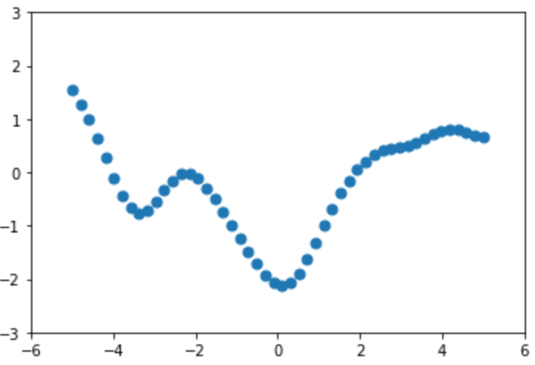
Gaussian process overview
Probability Distribution | Stochastic Process
Governs random variables Applies to scalar or vector values | Governs properties of functions Think (loosely) of function f as infinitely long random vector, where each entry x specifies f(x)
Gaussian process is a generalization of the Gaussian probability distribution
C. E. Rasmussen & C. K. I. Williams, Gaussian Processes for Machine Learning, the MIT Press, 2006, ISBN 026218253X.

Slide 28
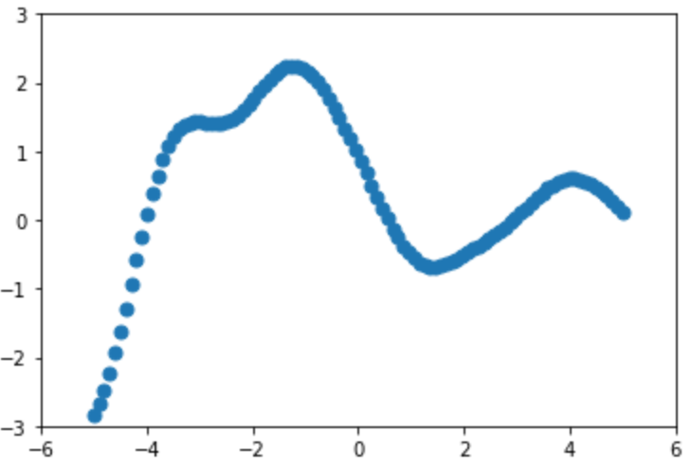
Gaussian process overview
Probability Distribution | Stochastic Process
Governs random variables Applies to scalar or vector values | Governs properties of functions Think (loosely) of function f as infinitely long random vector, where each entry x specifies f(x)
Gaussian process is a generalization of the Gaussian probability distribution
C. E. Rasmussen & C. K. I. Williams, Gaussian Processes for Machine Learning, the MIT Press, 2006, ISBN 026218253X.

Slide 29
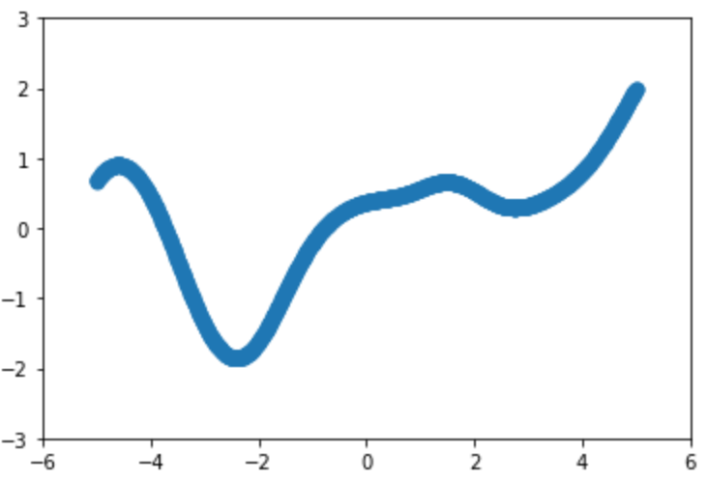
Gaussian process overview
Probability Distribution | Stochastic Process
Governs random variables Applies to scalar or vector values | Governs properties of functions Think (loosely) of function f as infinitely long random vector, where each entry x specifies f(x)
Gaussian process is a generalization of the Gaussian probability distribution
C. E. Rasmussen & C. K. I. Williams, Gaussian Processes for Machine Learning, the MIT Press, 2006, ISBN 026218253X.

Slide 30
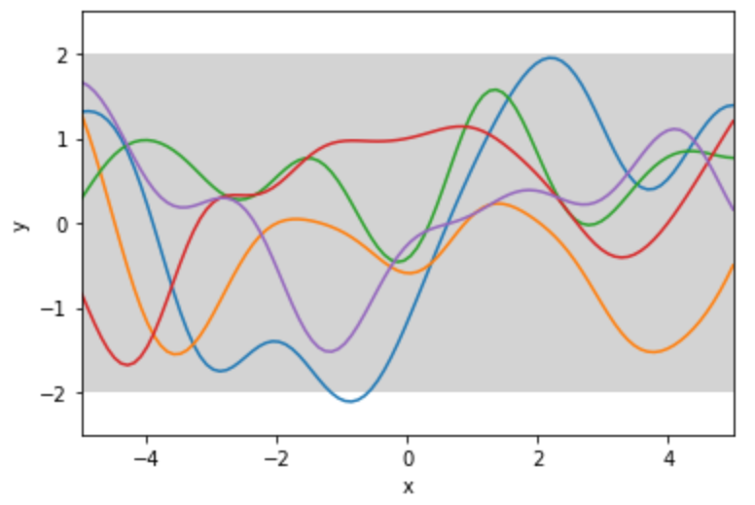
Pictorial example
prior
C. E. Rasmussen & C. K. I. Williams, Gaussian Processes for Machine Learning, the MIT Press, 2006, ISBN 026218253X.

Slide 31
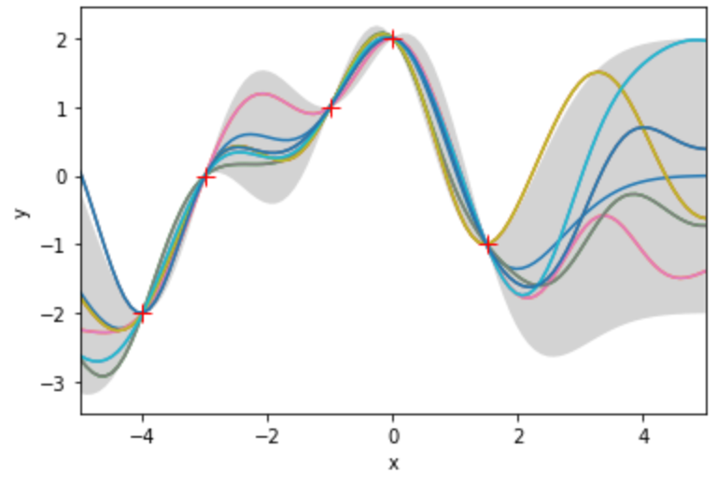
Pictorial example
prior
posterior
C. E. Rasmussen & C. K. I. Williams, Gaussian Processes for Machine Learning, the MIT Press, 2006, ISBN 026218253X.

Slide 32

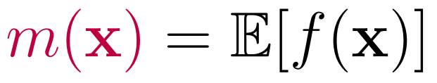






Gaussian process definition
A Gaussian Process is a collection of random variables, any finite number of which have a joint Gaussian distribution
Mean function
Covariance function
Correspondence with
Gaussian distribution
random variable for the case
infinitely long mean vector
infinite-dimensional covariance matrix:
C. E. Rasmussen & C. K. I. Williams, Gaussian Processes for Machine Learning, the MIT Press, 2006, ISBN 026218253X.

Slide 33






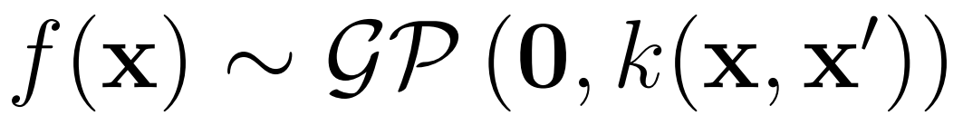
Marginalization property makes Gaussian processes tractable
Multivariate Gaussian distribution
Gaussian process
Variables
Let and be jointly Gaussian random vectors.
Let be a matrix of inputs with corresponding outputs . Let be a different matrix of inputs with corresponding outputs . Let .
C. E. Rasmussen & C. K. I. Williams, Gaussian Processes for Machine Learning, the MIT Press, 2006, ISBN 026218253X.

Slide 34
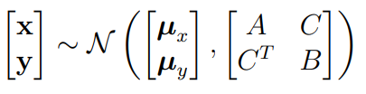
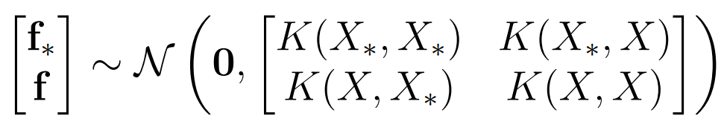
Marginalization property makes Gaussian processes tractable
Multivariate Gaussian distribution
Gaussian process
Variables
Let and be jointly Gaussian random vectors.
Let be a matrix of inputs with corresponding outputs . Let be a different matrix of inputs with corresponding outputs . Let .
Joint
Marginalization Property
C. E. Rasmussen & C. K. I. Williams, Gaussian Processes for Machine Learning, the MIT Press, 2006, ISBN 026218253X.

Slide 35




Marginalization property makes Gaussian processes tractable
Multivariate Gaussian distribution
Gaussian process
Variables
Let and be jointly Gaussian random vectors.
Let be a matrix of inputs with corresponding outputs . Let be a different matrix of inputs with corresponding outputs . Let .
Joint
Marginalization Property
C. E. Rasmussen & C. K. I. Williams, Gaussian Processes for Machine Learning, the MIT Press, 2006, ISBN 026218253X.

Slide 36
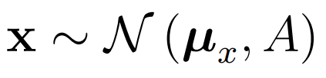

Marginalization property makes Gaussian processes tractable
Multivariate Gaussian distribution
Gaussian process
Variables
Let and be jointly Gaussian random vectors.
Let be a matrix of inputs with corresponding outputs . Let be a different matrix of inputs with corresponding outputs . Let .
Joint
Marginalization Property
Marginal
C. E. Rasmussen & C. K. I. Williams, Gaussian Processes for Machine Learning, the MIT Press, 2006, ISBN 026218253X.

Slide 37

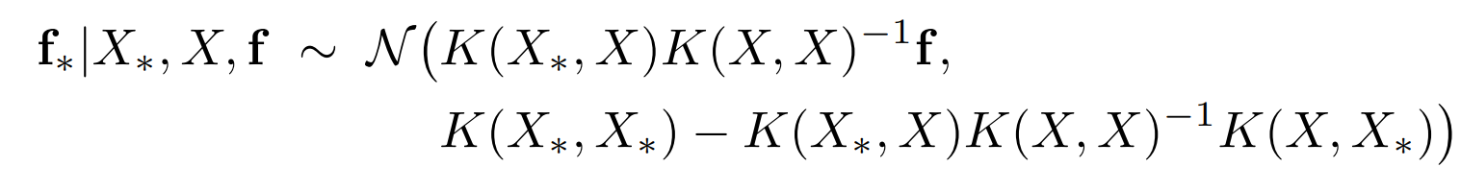
Marginalization property makes Gaussian processes tractable
Multivariate Gaussian distribution
Gaussian process
Variables
Let and be jointly Gaussian random vectors.
Let be a matrix of inputs with corresponding outputs . Let be a different matrix of inputs with corresponding outputs . Let .
Joint
Marginalization Property
Conditional
C. E. Rasmussen & C. K. I. Williams, Gaussian Processes for Machine Learning, the MIT Press, 2006, ISBN 026218253X.

Slide 38


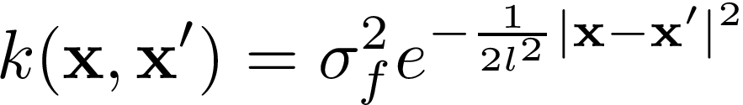
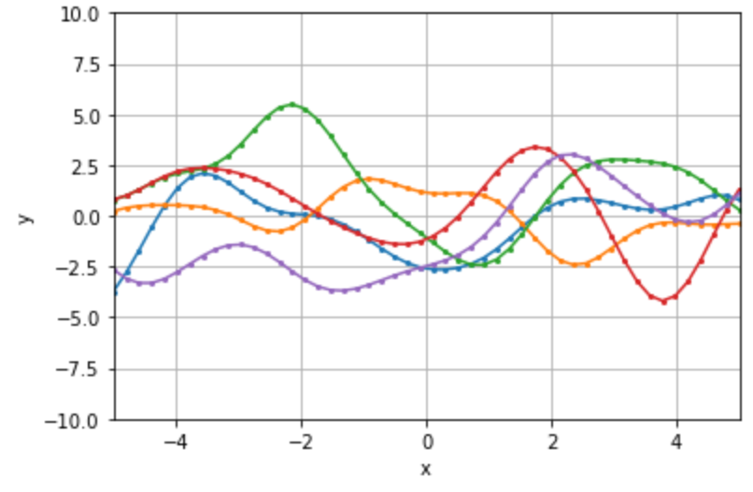

Gaussian process gives a prior distribution over functions
Prior distribution of outputs via marginalization property:
Covariance function encodes function attributes:
Functions are smooth (SE is differentiable)
characteristic length scale
overall variance
Functions drawn from prior
“Squared exponential”
hyperparameters
C. E. Rasmussen & C. K. I. Williams, Gaussian Processes for Machine Learning, the MIT Press, 2006, ISBN 026218253X.

Slide 39



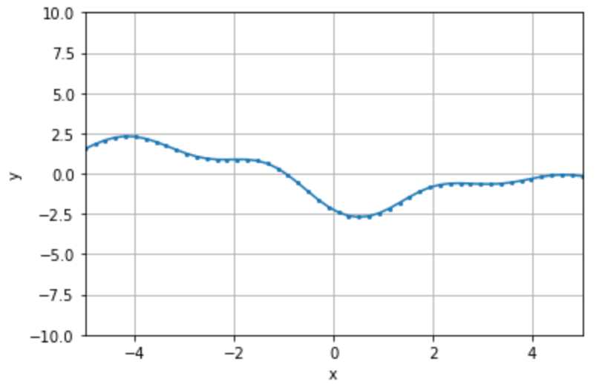
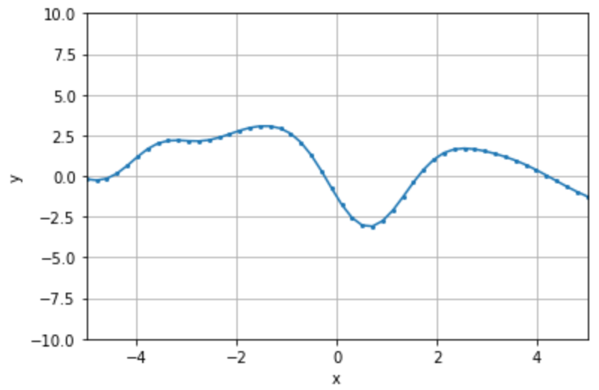
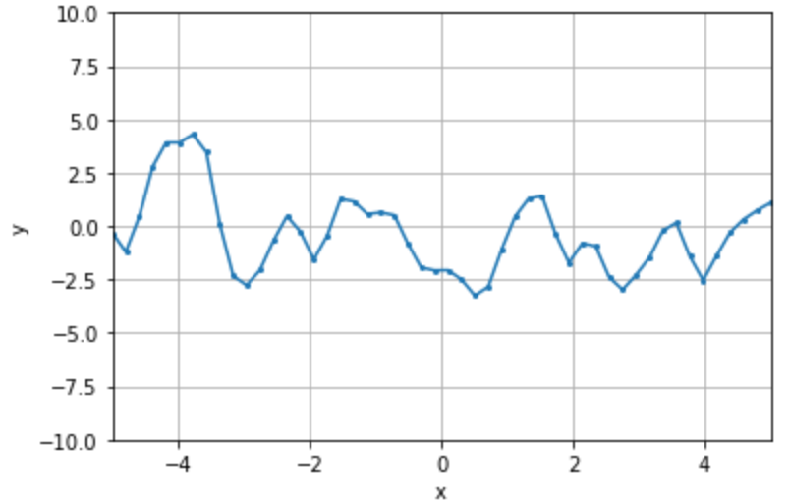
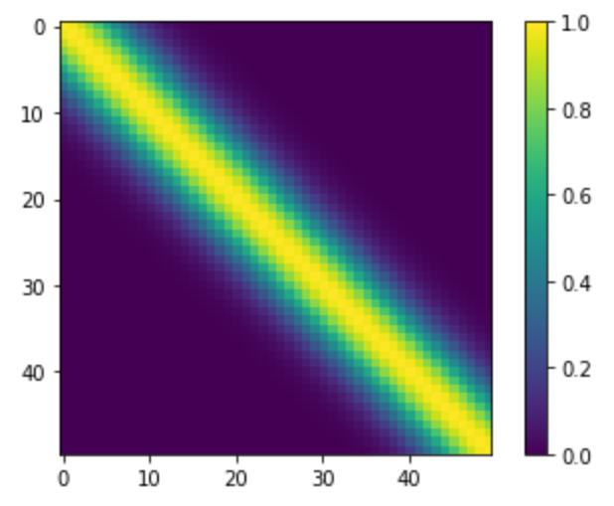
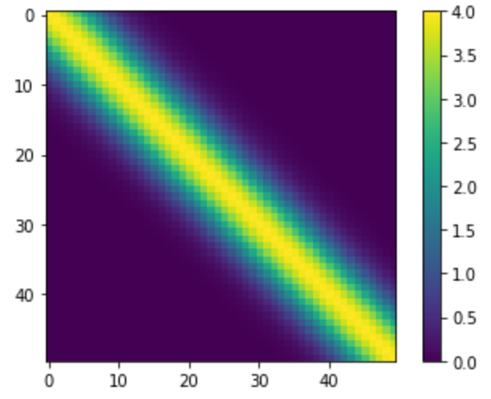
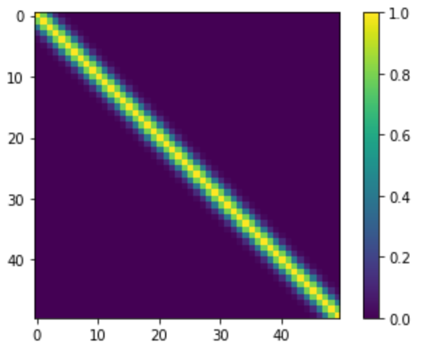
Example functions drawn from prior
Hyperparameters
Function
Covariance
Matrix
C. E. Rasmussen & C. K. I. Williams, Gaussian Processes for Machine Learning, the MIT Press, 2006, ISBN 026218253X.

Slide 40



Prediction with noise-free observations
Empirical dataset and test points along with the model yields:
Joint distribution (via marginalization property)
Conditional distribution
C. E. Rasmussen & C. K. I. Williams, Gaussian Processes for Machine Learning, the MIT Press, 2006, ISBN 026218253X.

Slide 41
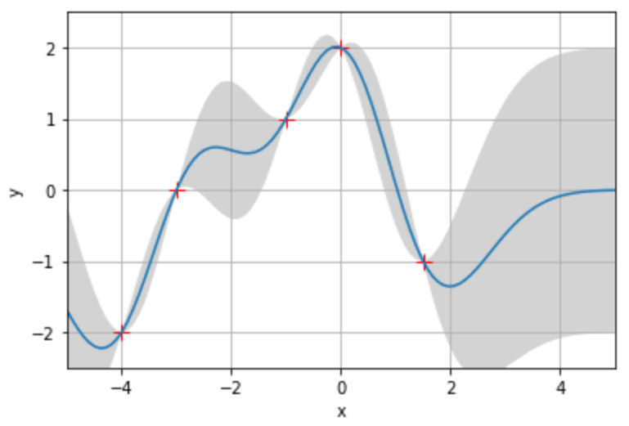
Prediction with noise-free observations
Training Data
Mean predictions with uncertainty estimates
C. E. Rasmussen & C. K. I. Williams, Gaussian Processes for Machine Learning, the MIT Press, 2006, ISBN 026218253X.

Slide 42
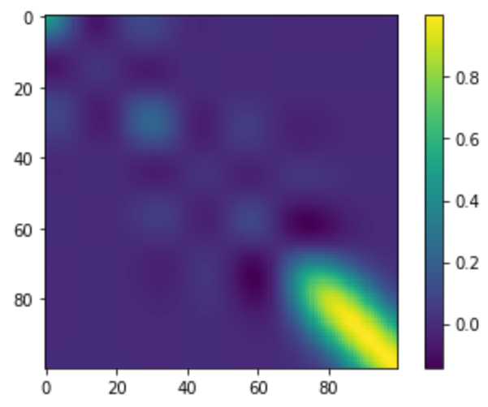
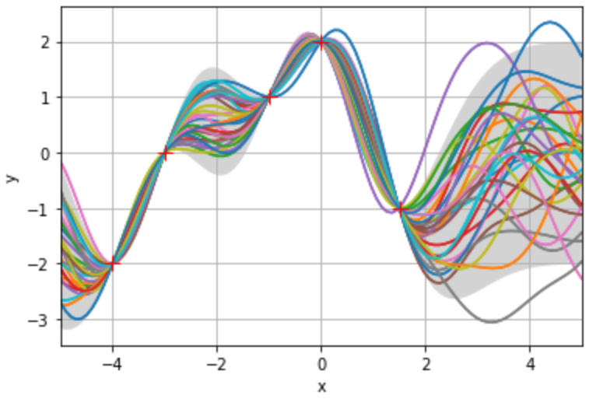
Prediction with noise-free observations
Training Data
Mean predictions with uncertainty estimates
Covariance Matrix
30 functions drawn from posterior
C. E. Rasmussen & C. K. I. Williams, Gaussian Processes for Machine Learning, the MIT Press, 2006, ISBN 026218253X.

Slide 43
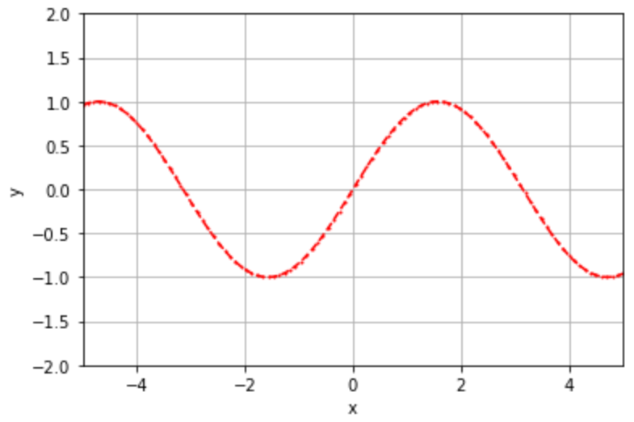
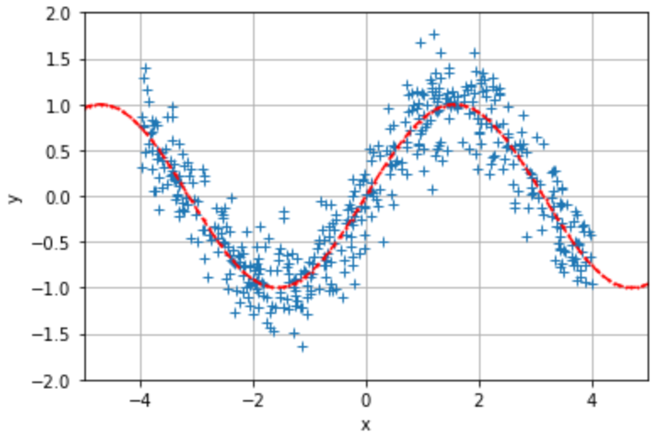
Prediction with noisy observations
Sine function
Noisy measurements
C. E. Rasmussen & C. K. I. Williams, Gaussian Processes for Machine Learning, the MIT Press, 2006, ISBN 026218253X.

Slide 44

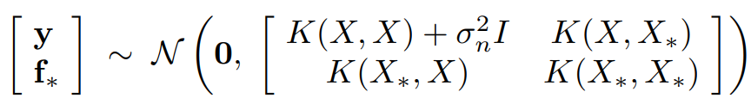






Prediction with noisy observations
Prior on the observations
Joint distribution
Conditional distribution of measurements
C. E. Rasmussen & C. K. I. Williams, Gaussian Processes for Machine Learning, the MIT Press, 2006, ISBN 026218253X.

Slide 45
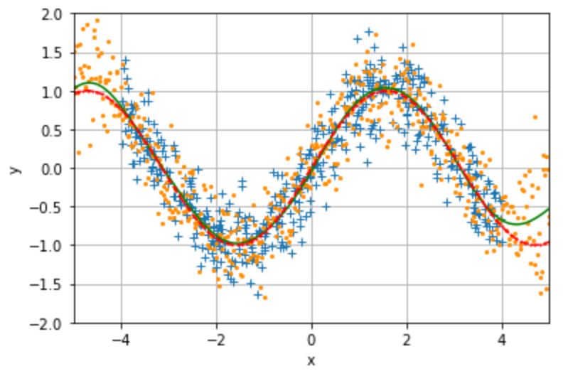
Prediction with noisy observations
Observations
Predictions
C. E. Rasmussen & C. K. I. Williams, Gaussian Processes for Machine Learning, the MIT Press, 2006, ISBN 026218253X.

Slide 46
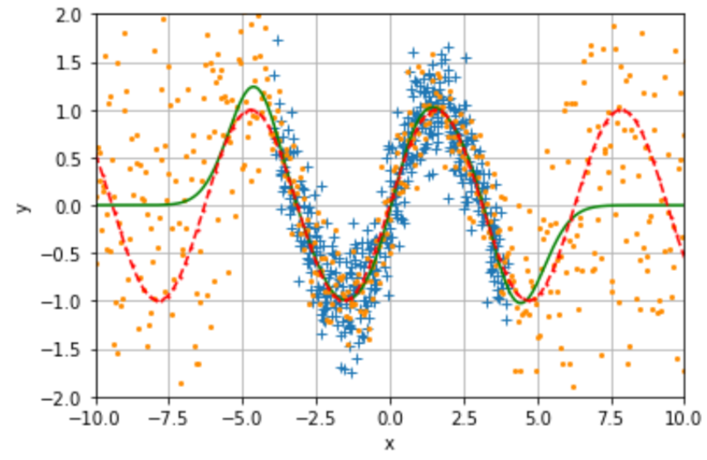
Prediction with noisy observations
Predictions
C. E. Rasmussen & C. K. I. Williams, Gaussian Processes for Machine Learning, the MIT Press, 2006, ISBN 026218253X.

Slide 47
Why are Gaussian processes useful and important?
Flexible tool that can be applied to a wide variety of problems, including both regression and classification
e.g. continuous approximation to latent space in VAEs for molecular discovery paper from last week
kernels can be chosen based on the problem at hand, and they can be composed together
Deep GPs can yield automatic kernel learning
Provide well-behaved uncertainty measurements
unlike other models such as many neural networks
Other widely-used models are a special case of Gaussian processes
a single hidden layer neural network converges to a Gaussian process in the limit of an infinite number of hidden neurons and with a Gaussian prior on the weights
equivalent to Bayesian linear regression with a (possibly) infinite number of basis functions
Nonparametric model has infinite capacity
C. E. Rasmussen & C. K. I. Williams, Gaussian Processes for Machine Learning, the MIT Press, 2006, ISBN 026218253X.

Slide 48
Limitations and approximations
Not that data efficient
with matrix inversion, Gaussian process algorithms cost O(N^3)
Datasets with more than 10,000s of data points could be problematic
Approximation algorithms exist for large datasets
Summarize data using a small number of pseudo-points
Expectation propagation pseudo-point approximation
Use M pseudo-points to approximate posterior, costs O(NM^2)
Split up data into chunks
C. E. Rasmussen & C. K. I. Williams, Gaussian Processes for Machine Learning, the MIT Press, 2006, ISBN 026218253X.

